Slide 1

Key ingredients of an ELT course?
Does it engage and motivate students?
Does it make life easy for teachers?
Does it match the age / ability range?
Is it affordable?
What are the components and design?
What are its learning aims?
Exams, test results, jobs?
“General education”, thinking skills?
Communication skills?

Slide 2
What is a ‘general education’ in EFL?
Critical thinking, 21st Century skills, articulacy, creativity
Knowledge of the globalised world and how it works
Attitudes and values – at its best what Europe stands for
Things that mainstream education does not have time for:
How to deal with modern media
Philosophy for life
Understanding other cultures, tolerance, dealing with –isms (nationalism, extremism, liberalism)
Skills in discussion, listening to arguments and replying to them logically
Research and enquiry and using the results creatively
Arts, literature, film, drama, music, sport and issues connected with them
Notes:
2

Slide 3
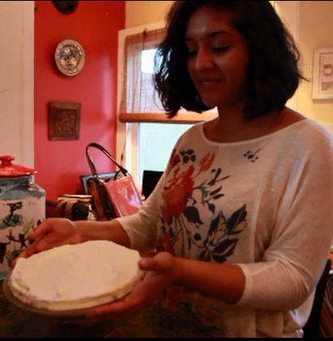
Lily’s banana cream pie
LILY LIKES COOKING:
The reasons …
The best types …
The ingredients …
The method …
Film: Teen cook, Smart English A2 Unit 10A

Slide 4

Notes:
Smart English A2 Video 19, Unit 10 Teen cook
4

Slide 5

Lily’s dish = Smart English / QSE
Reasons for using SE A2 & QSE
Best types of teaching / learning
Key ingredients of course
Method for learning effectively
Price…

Slide 6
The reasons…
These four courses are different
Taking risks for better content and ideas
Experimenting with learning (articulacy)
Authentic content and conversations
Student generated videos, writing etc
Methods that promote communication

Slide 7
The best types…
International teams / international English
UK / US authors, Rebecca Robb Benne and Anna Whitcher, London & San Francisco
Contributing teachers and students from Australia, Brazil, Bulgaria, Chile, China, Denmark, Germany, Iran, Mexico, Russia, San Salvador, Spain, UK and USA.
Notes:
British English and US English and other types as well – Australian and Non-natives

Slide 8
The best types…
Student-generated content
In 24 videos, real teenagers from around the world talk about their lives.
Authentic writing models, written by real learners, Like Donislav, using online tools with their own photos and graphics.
Notes:
8

Slide 9
Key ingredients 1-5
24 integrated videos (great authentic stories)
Every video comes with activities in Video Pack
CEFR-based syllabus, A2 level, 120+ hour course
Trinity GESE Grades 3 and 4, Cambridge KET
The BIG Question starts every Unit
Notes:
9

Slide 10
Key ingredients 6-10
Simple 10-step structure to very Unit
Grammar and CLIL in every Unit – SB and WB
Student-generated online writing tasks in every Unit
Extended reading with 4 famous teenage fiction texts
Workbook + CD with grammar, pronunciation, CLIL
Notes:
10

Slide 11

Key ingredients 11-15
Frequent revision in exam format (KET)
Language Banks on fold-out cover flaps
Teacher’s Guide: online; quick and easy
British Council ELTons nominated: “
“Excellence in Course Innovation”
Split Editions, SB+WB, Parts A & B
Notes:
11

Slide 12
The reasons …
QSE is different
The main aim is development of SPEAKING
Four skills, vocabulary and grammar
Many authentic and controversial topics
British, American and GLOBAL English
Relevant to the times - CLIL, critical thinking…
Notes:
These books were ahead of their times when published and they are still HIGHLY RELEVANT today.
TOPICS like
12

Slide 13




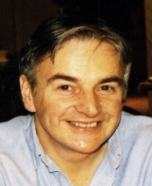

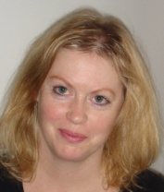
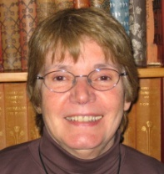
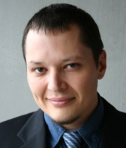

The best types – authors…
Ken Wilson Mary Tomalin Rebecca Robb Benne Dr Joanne Collie Maurice Forget Anna Whitcher
Notes:
13
QSE AUTHORS - all teachers or ex-teachers now full time writers and they too are always on the look out for new ideas.
Here is what author Ken Wilson said at the beginning of the Quick Smart English project:
“EFL materials should provide strategies to help students express their opinions about local and global issues that matter to them; they need functional language, vocabulary and evidence (from reading and listening material) to help them say (and write) what they think.”

Slide 14
QSE best types…
BIG QUESTIONS such as:
Is there life without social media? (A2)
Who needs rules? (B1)
Is security more important than privacy? (B2)
Are we alone in space? (B2)
Does economics really affect me? (C1)
Are students learning the right things? (C1)
Notes:
14

Slide 15
QSE ingredients 1-5
Wide range of controversial topics for debate
CEFR-based syllabus, 100+ hours per level
Trinity College London GESE Grades 4 – 11
Cambridge PET, FCE, CAE, IELTS
The BIG Question starts every Unit
Notes:
15

Slide 16
QSE ingredients 6-10
Simple 10-step structure to very Unit
CLIL section in every Unit
Extended reading – literature, reportage, fantasy
Workbook with grammar, pronunciation, CLIL
Extra activities online
Notes:
16

Slide 17
QSE ingredients 11-15
Frequent revision for exams (PET, FCE, CAE)
Language Banks on fold-out cover flaps
Teacher’s Guide: easy to use, downloadable
Authentic video at C1 level (BBC, US networks)
Split Editions, SB+WB, Parts A & B (B1, B2)
Notes:
17

Slide 18
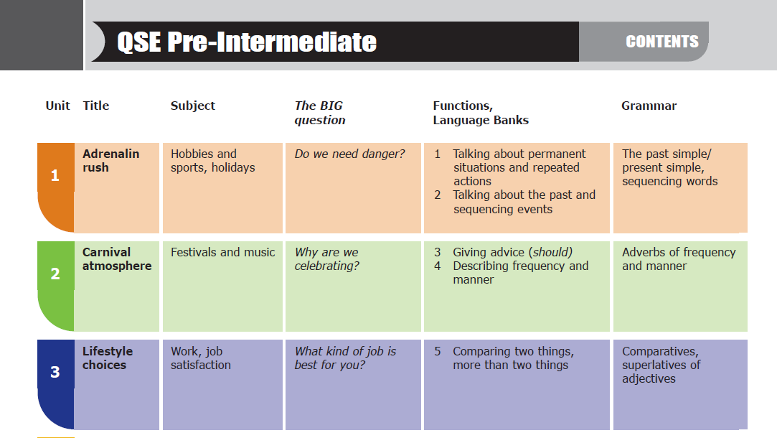
Map of the book:QSE Pre-Intermediate A2-B1

Slide 19
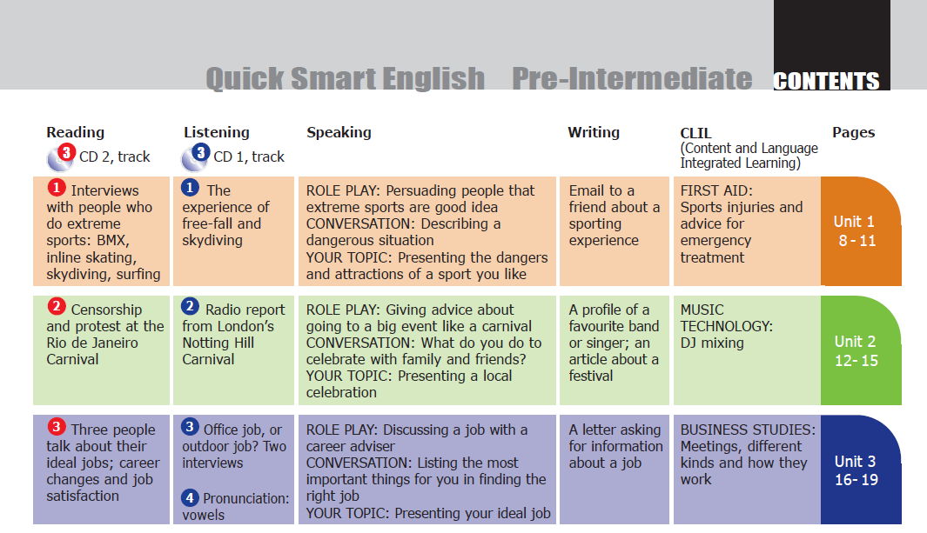
Map of the book 2:QSE Pre-Intermediate A2-B1
Notes:
19

Slide 20
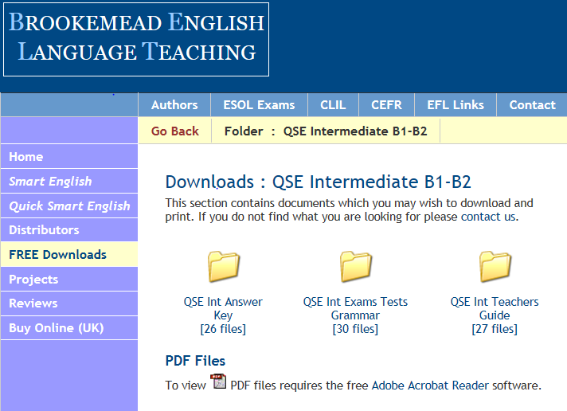
Map of the TG:QSE Intermediate B1-B2
FREE Downloads from website
Notes:
20

Slide 21
Extra worksheets: QSE Pre-Intermediate A2-B1
Grammar and Usage – Workbook pages for each Unit with explanation and practice, vocabulary and pronunciation (with audio) plus Progress Checks
Notes:
21

Slide 22
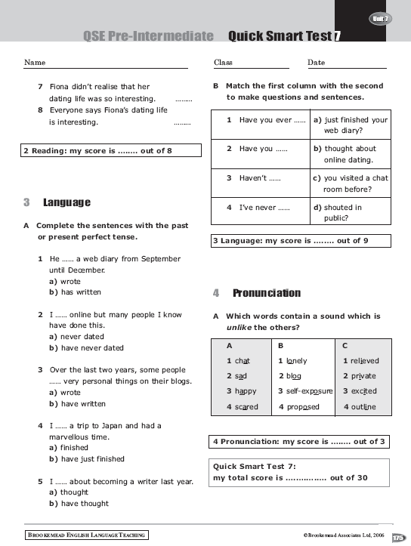
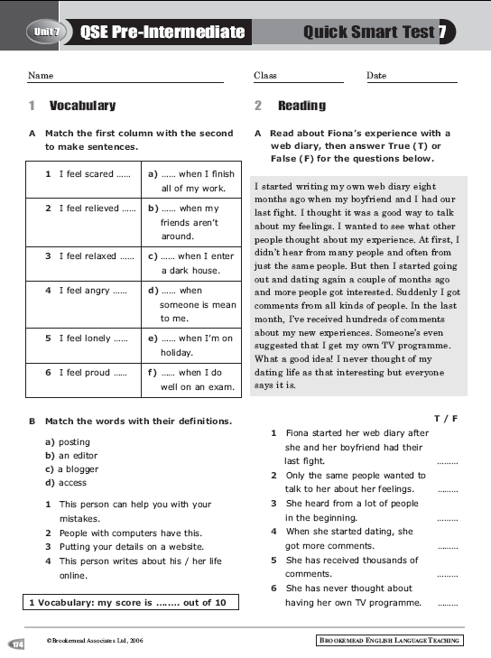
Extra worksheets: QSE Pre-Intermediate A2-B1
Exam practice and Tests – photocopiable pages for each Unit in the Teacher’s Guide
Notes:
22

Slide 23
Smart English A2
Notes:
23

Slide 24
10 Step Units: Smart English A2
The Big Question
Vocabulary
Listening
Role play
Reading
Grammar
Conversation (Trinity)
CLIL (video)
Writing (Cambridge KET)
Your Answer
Notes:
24

Slide 25
10 Step Units: QSE Pre-Intermediate A2-B1
The Big Question
Focus on
Reading
Language/grammar
Listen In
Your Turn to Speak (Language Bank)
Your Topic (Trinity)
CLIL
Portfolio Writing (Trinity, Cambridge)
Your Answer

Slide 26

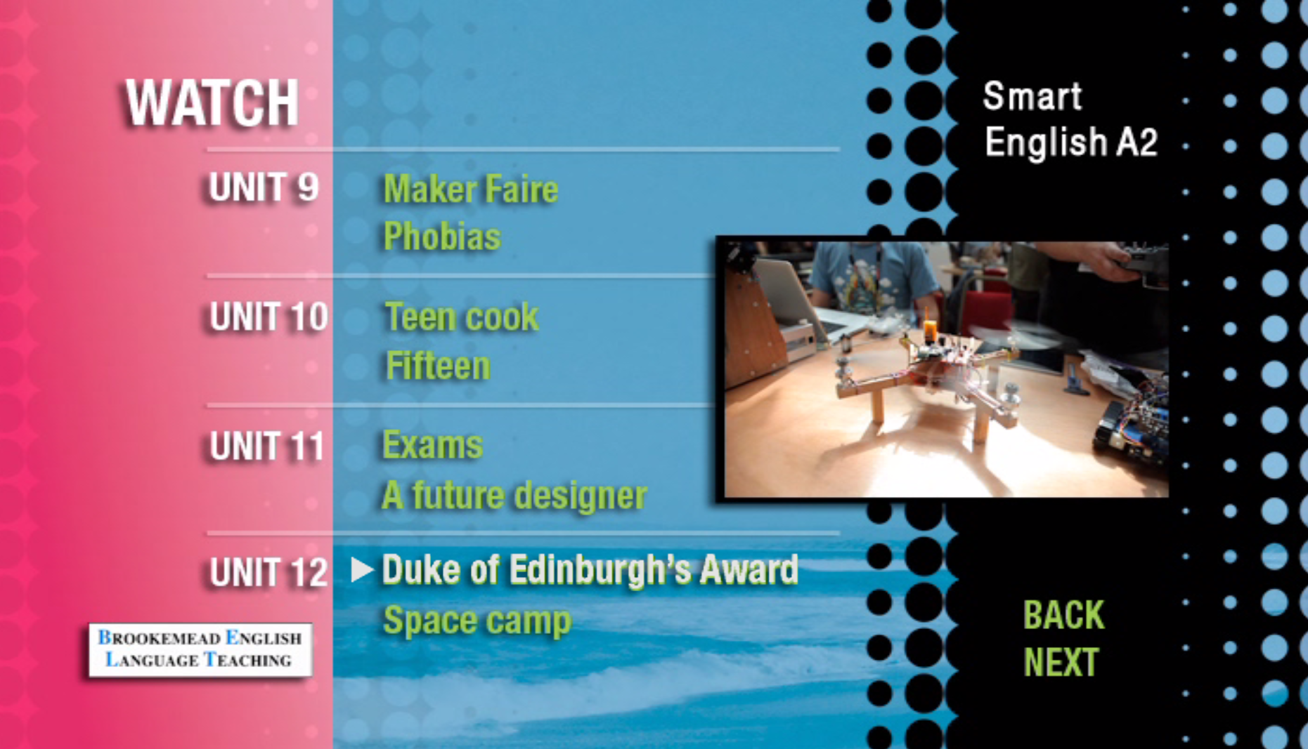
Videos
Authentic, student-centred stories
Student-generated content
Follow their lives, interests, skills
Grammar and vocabulary of the unit
www.brookemead.com
Notes:
26

Slide 27
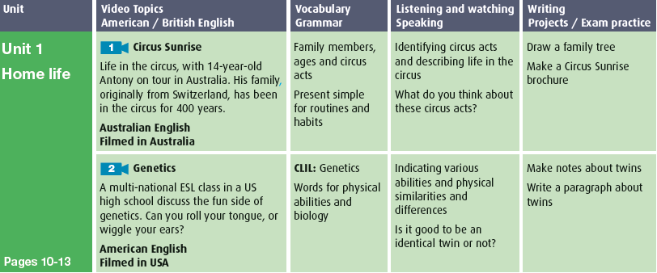
grammar structure:
Videos
Going to (future)
Should, shouldn’t (for what to do or not in exams)

Slide 28
Using video for CLIL: Genetics

Slide 29
Notes:
Smart English A2 Unit 1, Video 2 Genetics

Slide 30

CLIL in every Unit
CONTENT
COMMUNICATION
COGNITION
CULTURE
Hard CLIL and Soft CLIL – the broader curriculum
Cambridge TKT – using the 4 C’s in CLIL teaching
Notes:
Example from QSE Intermediate B1-B2 that is actually used in the Cambridge English TKT Exam Course as an example of good practice in using the 4 C’s in CLIL teaching.
CLIL and the 4 Cs CONTENT COMMUNICATION COGNITION CULTURE
Content: Subject concepts:
Work patterns in different industries
Subject skills: interpreting graphs
Communication:
Describing trends
Making comparisons
Cognition:
Remembering and classifying types of work
Analysing data in a graph; evaluating
interpretations of a graph; comparing
industry in two countries
Culture:
Work in the UK and own country
Think about two CLIL lessons where
you have successfully incorporated all
4Cs.
Write about your focus on culture in
these lessons.

Slide 31

ONLINE WRITING: with Glogster
www.glogster.com
Choose a topic
Give students several writing prompts
Have them write bits of text
Have them select photos, videos and other graphics to illustrate their ideas
Notes:
31
Here are some examples of online writing we commissioned for one of our books.
These are all great sites for motivating students to WRITE, PUBLISH AND SHARE THEIR OWN WORK.

Slide 32


Slide 33
ONLINE WRITING: www.storybird.com
Good for all levels since students write all of their own text
Can be simple or complex
Wide variety of art gives inspiration
Authentic student produced content
Structured using writing frames
Notes:
Structured writing… writing frames which guide the student all the way

Slide 35
What the customer says…
Notes:
35

Slide 37

Duncan Prowse
dp@brookemead.com
www.brookemead.com
LONDON • SAN FRANCISCO

